Slide 1
Analysis of Autonomous systems and its temporal dimensions using Social network analysis

Slide 2
Abstract
The main objective of this project is to building a successful modeling tool able to generate realistic graphs for use in networking simulations.
In this project we provide a detailed analysis of the inter-domain topology of the Internet. The collected data and the resulting analysis will be based on one-year span routing dataset, we give results concerning major topology properties (nodes and edges number, average degree and distance, routing policy, etc.) and main distributions degree, distance, etc.
We provide different types of visualizations and layouts for each and every property in the network, to the users for their convenience. Eventually, we will do data modelling based on the properties in the network.

Slide 3
Problem foundation && System Design
Our tool consisting a data of BGP dataset which consists of a AS number(router number), edges(connection between them)
In the existing network tools of BGP dataset, they didn’t have a different visualization techniques, network properties. We proposed the different visualization techniques among the various properties of the network.
Some of them are degree centrality, closeness centrality, betweeness centrality, community detection , cliques, hubs, degree distribution, clustering coefficient etc.

Slide 4
Experimental Setup
Hardware
To implement this tool, we need desktop or PC.
It can run on different platforms(like windows, linux, mac).
Software
we are using the software tool is R Studio.
RStudio is an integrated development environment (IDE) and language is R.
It is a open source and available in two formats: RStudio Desktop is a regular desktop application while RStudio Server runs on a remote server and allows accessing RStudio using a web browser.

Slide 5
Approach && Implemetation
Our project, is related to software. In our approach, we designed three steps
Step-1
Collecting the BGP dataset && converting the BGP data into graph or network:
We collected daily BGP routing data of different countries. BGP data set consists of router numbers and connections among them.
Eventually, we converted the data into graph or network with nodes and edges.

Slide 6
Step-2
Analyze and visualize the network
For analyzing the network, social network analysis is the best way by using the IDE as R studio. We used packages like visnetwork, igraph etc., for visualizing the network by using the R language.
SNA concepts like closeness, degree, betweeness, highlighting the nodes and edges etc and for visualization we used various techniques like bar plot, scatter plot, round view etc. Eventually, we found the trend analysis of a network.

Slide 7
Step -3
Dash board and data modeling
We developed the dashboard for the network for the user and operator convince. Also, we researched and analyzed the data modeling like small world networks, scale free networks.

Slide 8
Analysis
Some of the data modelling models we are going to use
1.Preferntial network
2.Small world networks
3. Scale free networks

Slide 9
Analysis and discussion
we researched on the data modeling. Some of the data modeling techniques are small world networks, large world networks and scale free networks.
Mainly, data modeling used for to model the data and used to enhance the network or graph in future.
Small world Networks
A small-world network is a network or mathematical graph in which most nodes are not neighbors, but the neighbors of a node in network are mostly to be neighbors of each other and most nodes can be reached from every other node by a small number of hops

Slide 10
Scale free networks
Scale free networks are the mathematical graphs or network which consists of large hubs. Scale free networks mainly consists of power law degree distributions, which power law consists same functions on different scales
As we researched on various research articles and various sizes of data, scale free networks model is suitable to the BGP routing dataset.
Because, every day route view BGP data is inconsistent, it varies. So, on every scales, power law consists of same functional forms in scale free networks. Eventually, for our project scale free networks are best for data modeling.

Slide 11
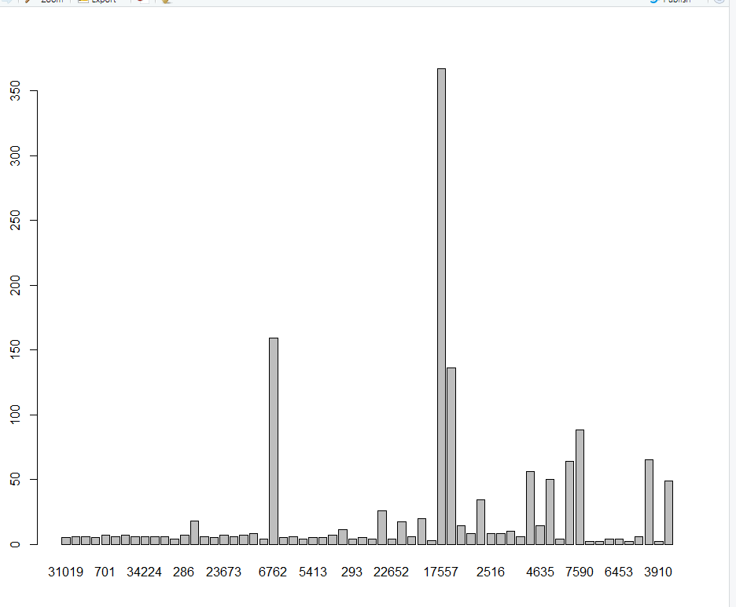
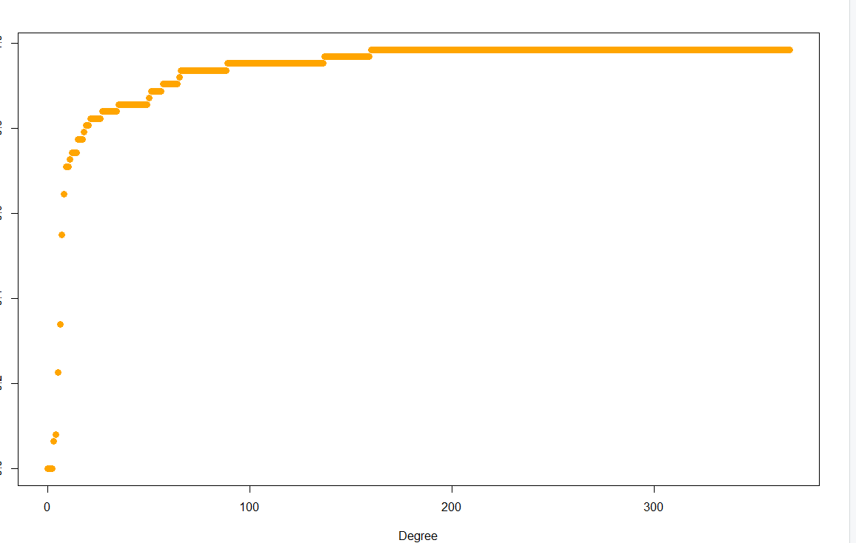
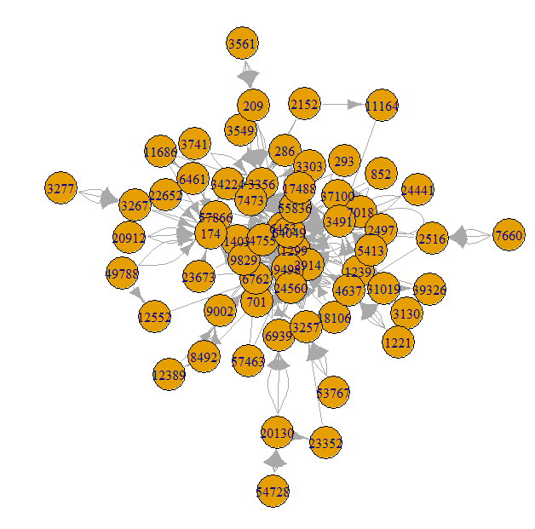
Implementation

Slide 12
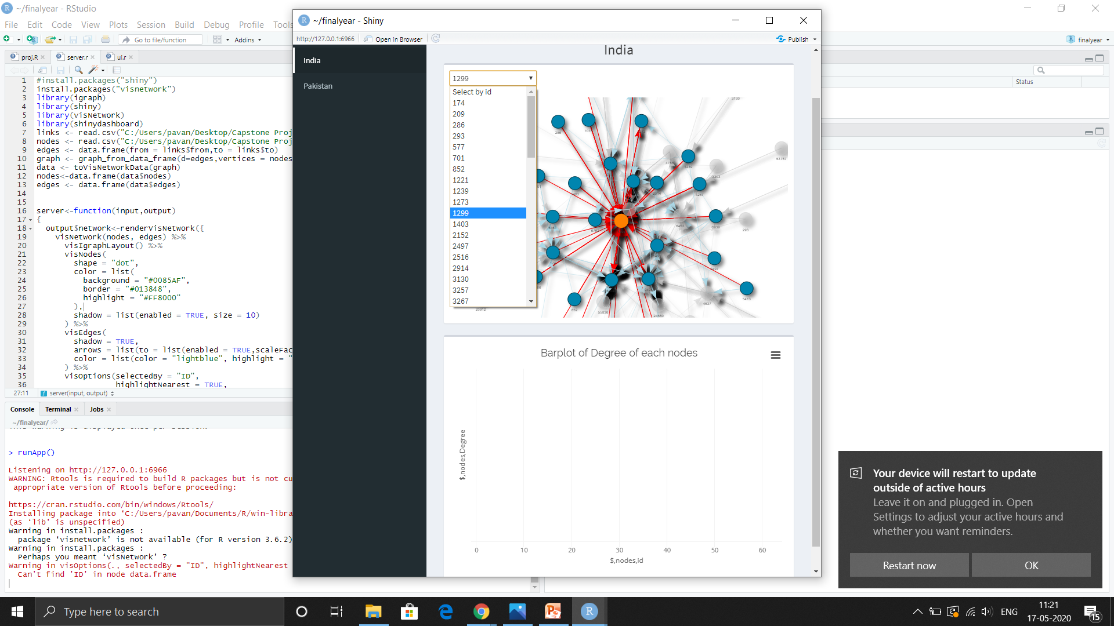
Dash board

Slide 13
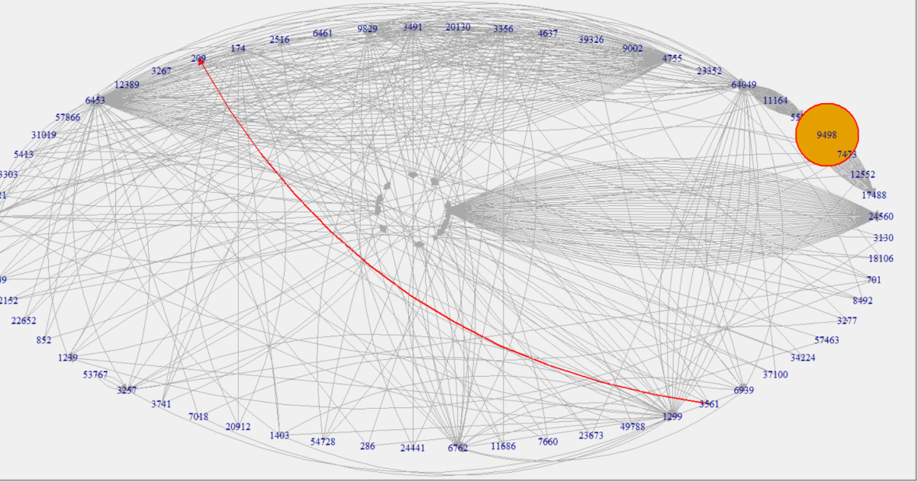
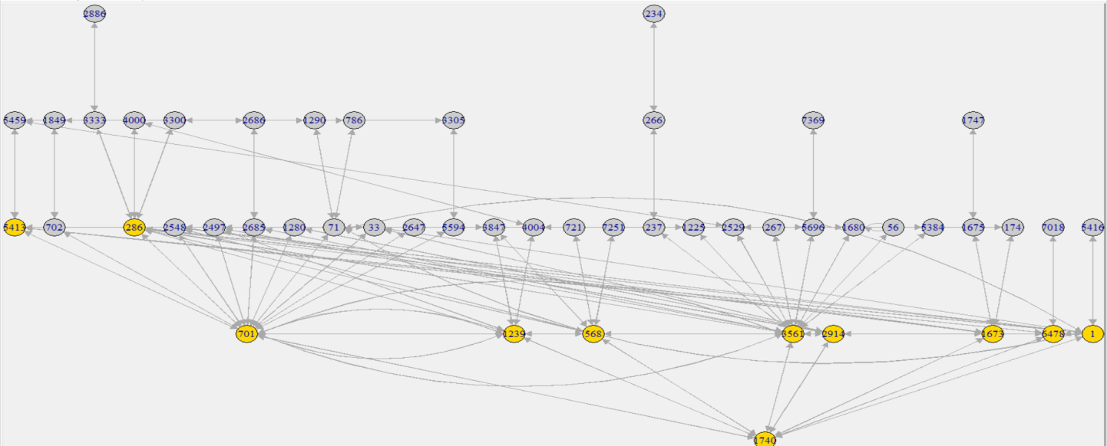
Implementation Some of the layouts and graphs in BGP network data

Slide 14
References
[1] Scholz-Reiter B, Rekersbrink H, Go¨ rges M (2010) Dynamic flexible flow shop
problems—scheduling heuristics vs. autonomous control. CIRP Annals – Manufacturing
Technology 59(1):465–468.
[2] Norstedt JP, Aguren S (1973) The Saab-Scania Report, Swedish Employers’
Confederation, Stockholm.
[3] Jovane F, Koren Y, Boer C (2003) Present and future of flexible automation:
towards new paradigms. CIRP Annals – Manufacturing Technology 52(2):543–
560.
[4] Van Brussel H, Wyns J, Valckenaers P, Bongaerts L, Peeters P (1998) Reference
architecture for holonic manufacturing systems: PROSA. Computers in Industry
37(3):255–274.
[5] Butala P, Sluga A (2006) Autonomous work systems in manufacturing networks.
CIRP Annals – Manufacturing Technology 55(1):521–524.

